Slide 1
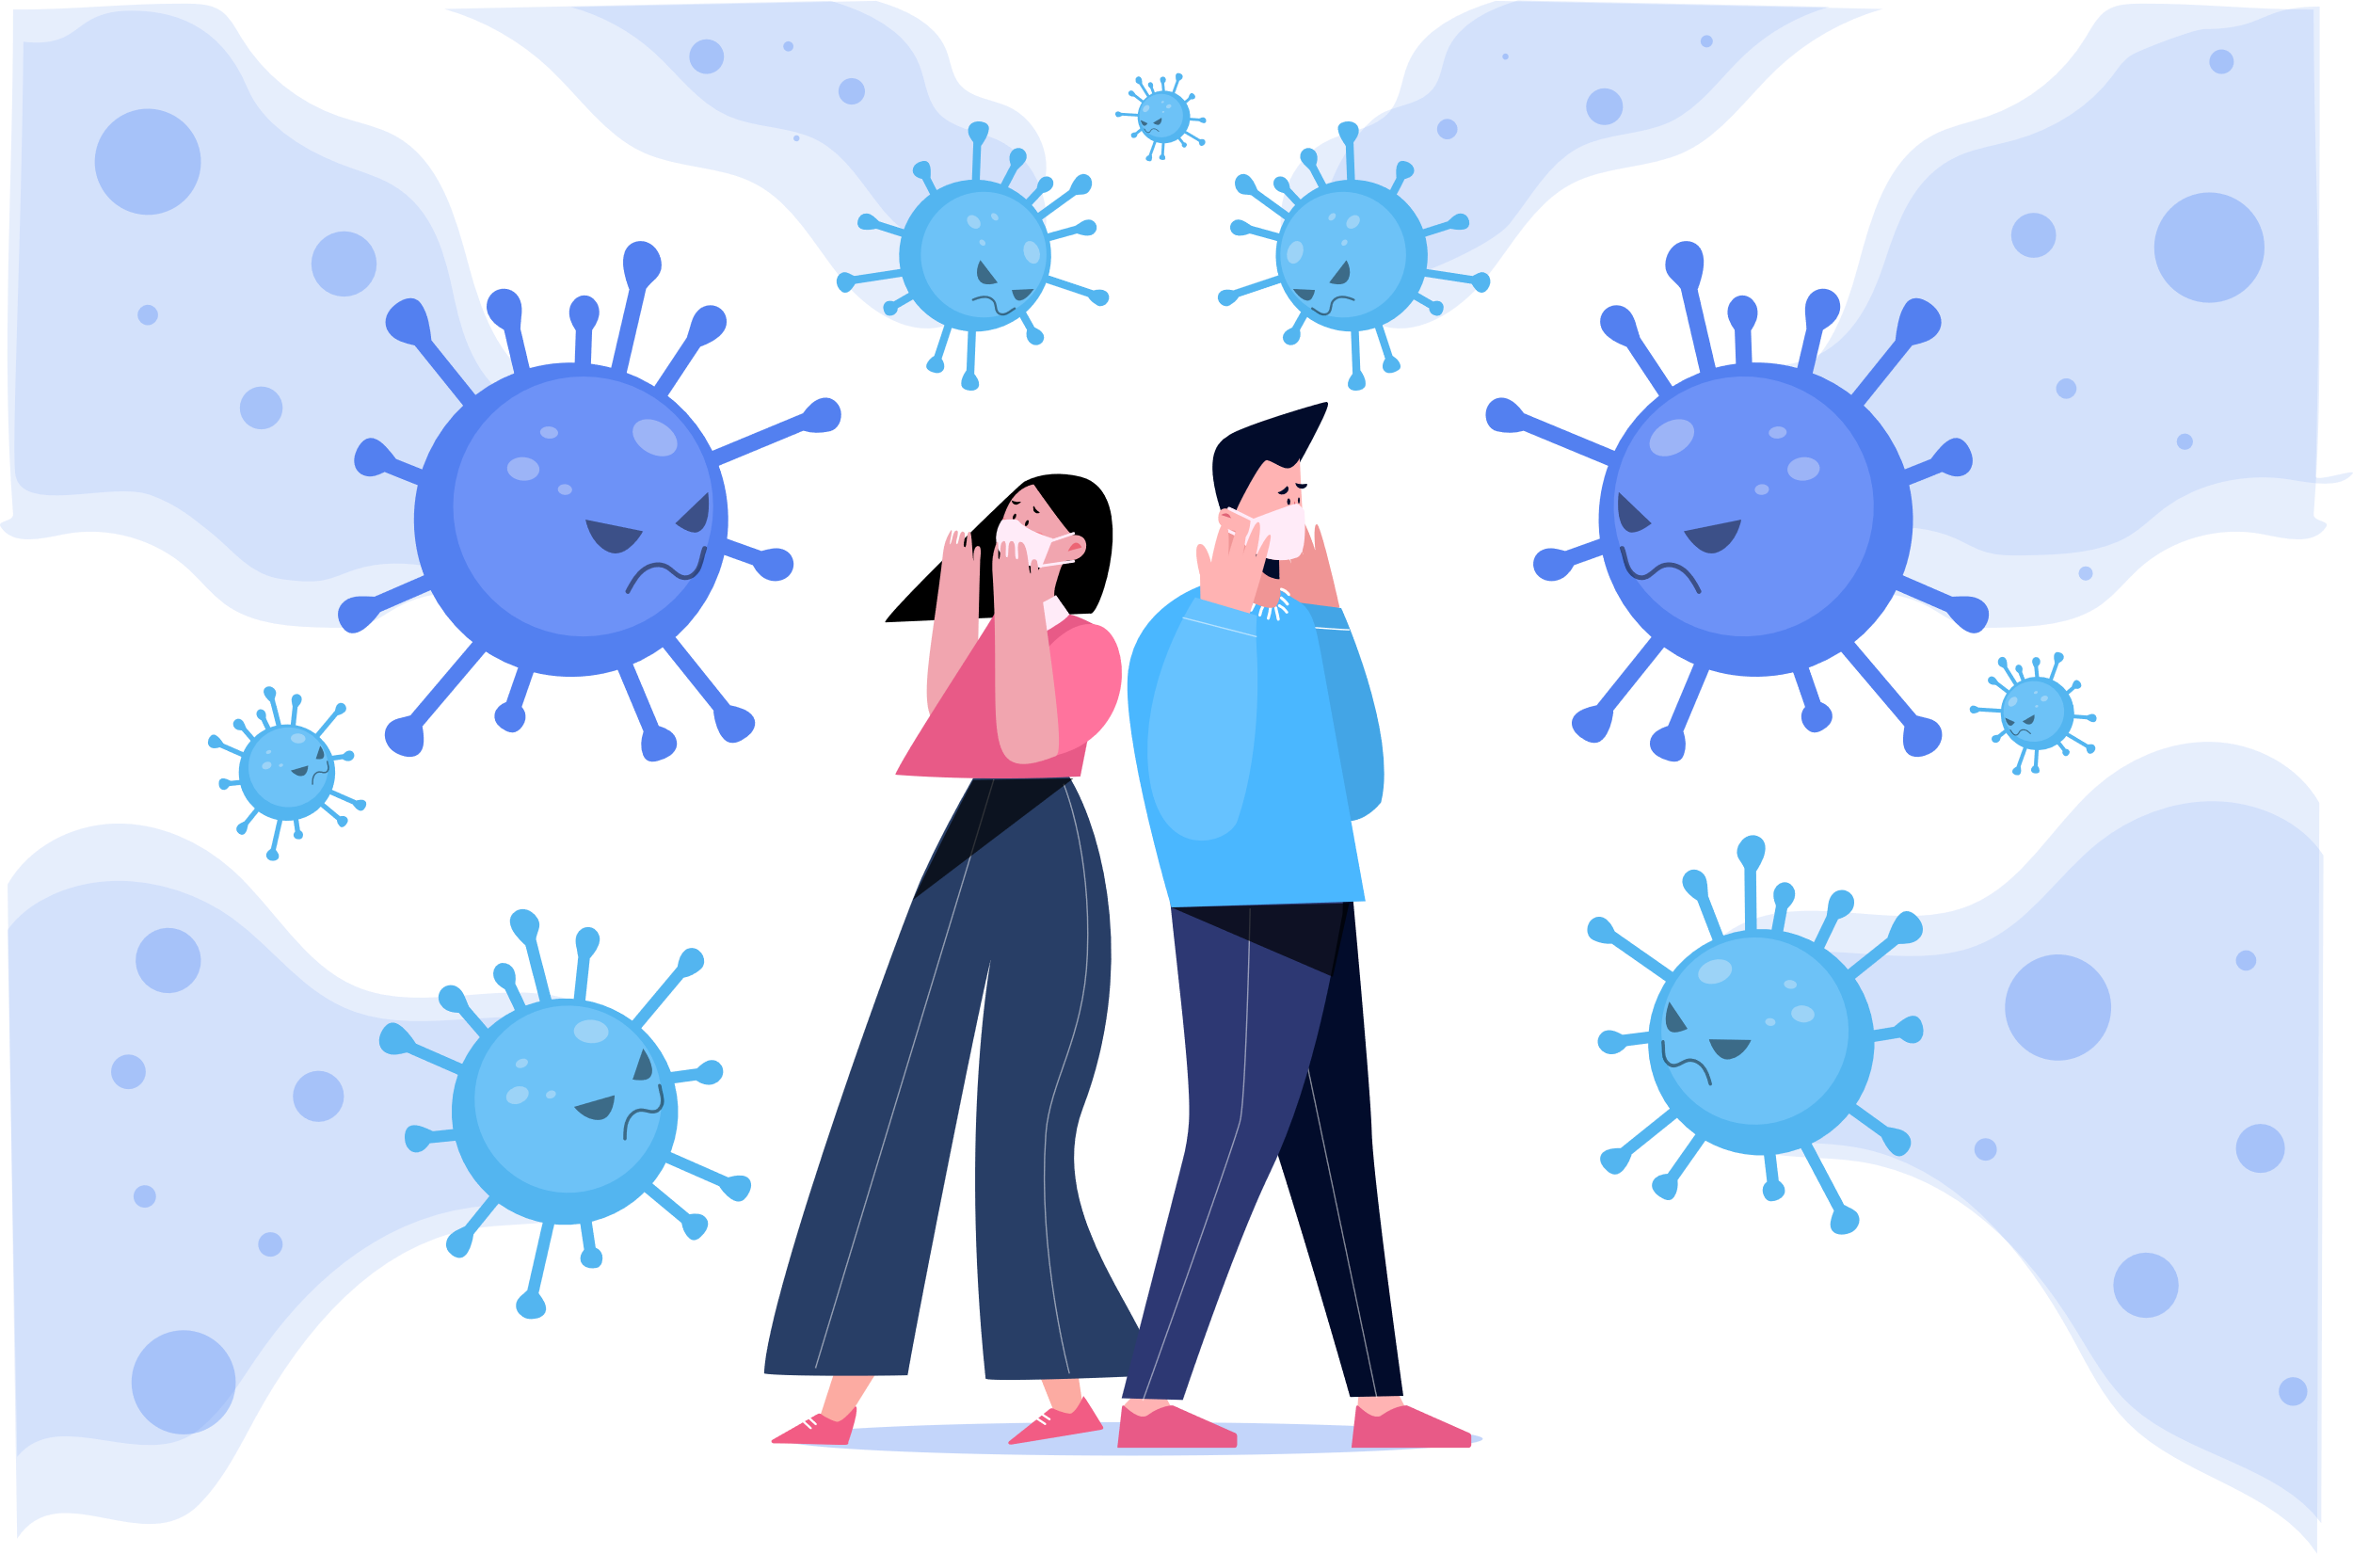
Detection of Covid-19
19
Abhijit Patil
21
Amitesh Patil
22
Kshitij Patil
23
Nikita Patil
24
Pranit Patil

Slide 2
Problem Statement
Novel corona virus or covid-19 is an ongoing pandemic caused by severe acute respiratory syndrome. Test for covid-19 takes few hours to few days depending upon which test you take. If it is detected little earlier then the infected person can take proper precautions and can help from spreading corona virus.

Slide 3


Objectives
Provide user friendly interface with useful information and precaution
Find reliable dataset
Create a CNN model for prediction
Maximize accuracy

Slide 4
Literature Review
A deep-learning based framework for automated diagnosis of COVId-19 using X-ray images: The diagnosis of COVID-19 was done by gold standard RT-PCR which was time consuming, complex in nature and high false negative rate that’s why there was a need of another method increased. Later, the studies had proved the significance of X-ray images for diagnosis.
A web-based Diagnostic Tool for COVID-19 Using Machine Learning on Chest Radiographs (CXR): Using Machine vision on chest radiographs (CXR) the model coronavirus COVID-19 is built. The model was further successfully validated on CXR images from an independent repository.
COVID-19 Prediction and Detection Using Deep Learning: In this study, they analyzed the incidence of COVID-19 distribution across the world. They presented an artificial-intelligence technique which was based on deep convolutional neural network (CNN) to detect COVID19 patients using real-world datasets. This system also, examines chest X-ray images to identify such patients.

Slide 5






Tools
Code Editor
FrontEnd
Visual Studio code
Jupyter Notebook.
HTML, CSS
Back End
DL Tool
Django
Resnet 18

Slide 6
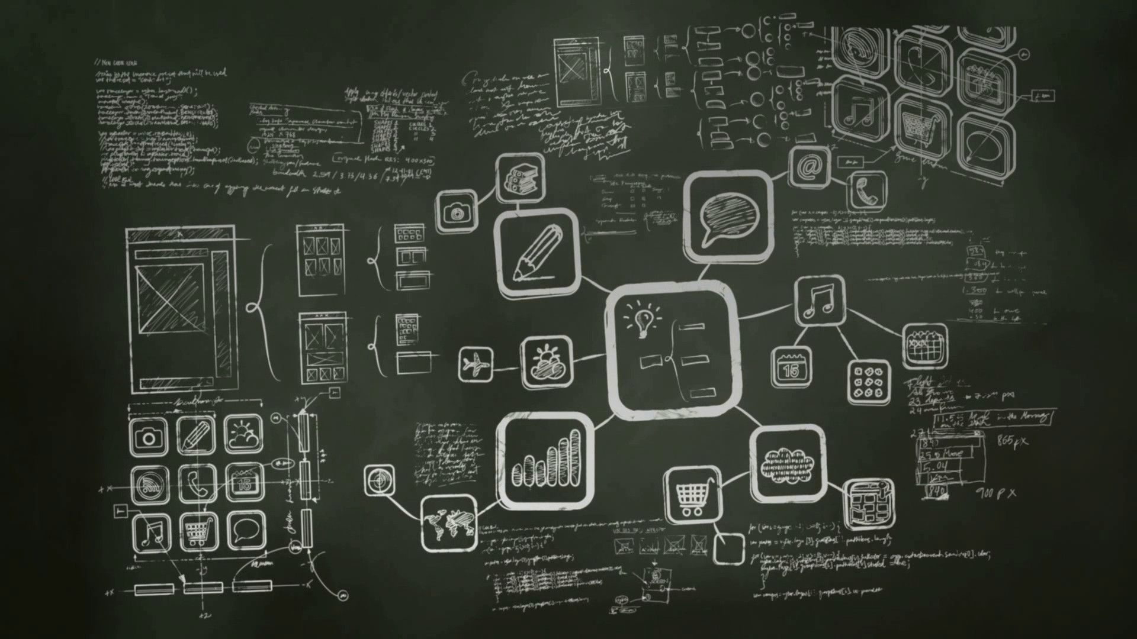

Methodology:
Finding dataset
Data-pre processing and augmentation
Convolutional Neural Network
Classification method and optimization
Model Deployment using Django
Making User Friendly Interface

Slide 7


Importing Libraries - shutil , torch , torch Vision
Preparing Training and TestSets
- Creating Directiory for First time from source directiories for 'normal', 'viral', 'covid‘
-making the x-ray image in .png format
-Selecting any 30 random images from dataset
Creating Custom Datasets
- Transforming image
- Taking image from each class and checking for its .png format
- Checking no. of images in dataset
- Avoiding Bouncing and Converting to RGB
Image Transformation
- Resizing image in 224 by 224 px.
- Normalizing training and testing image by mean=[0.485, 0.456, 0.406], std=[0.229, 0.224, 0.225]
Preparing DataLoader
Making Directiores i.e for Training and Testing Containing Covid , Normal and Viral
Batch making ,keeping size 6
Selecting image form batches for Training and Testing

Slide 8

The Model:
ResNet18 is a deep learning model used in computer vision.
Architecture is designed to take advantage of 2D structure like input image
Gives good performance in image analysis and image detection
It consists of various layers like conv2d, pooling, dropout etc.

Slide 9
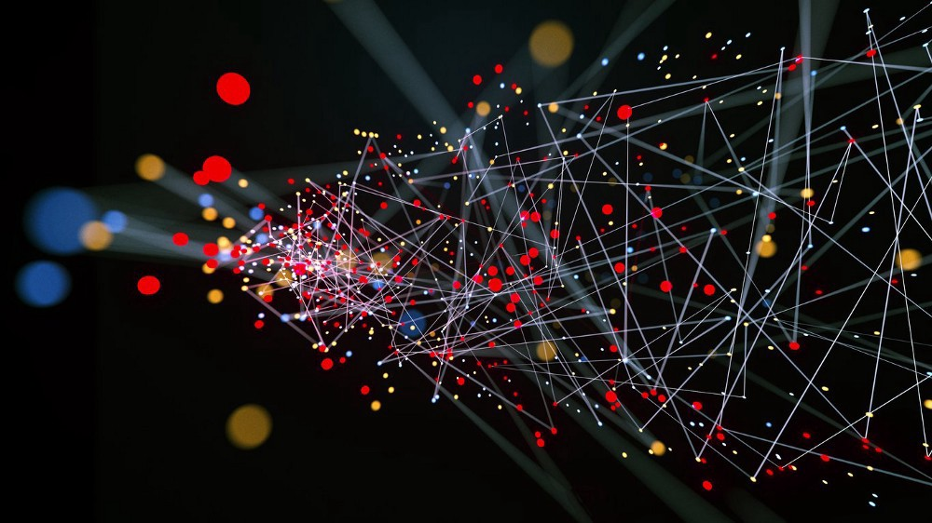
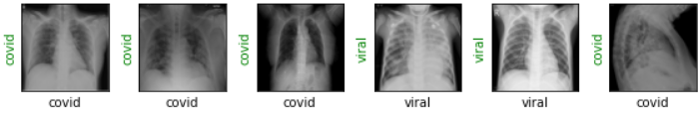
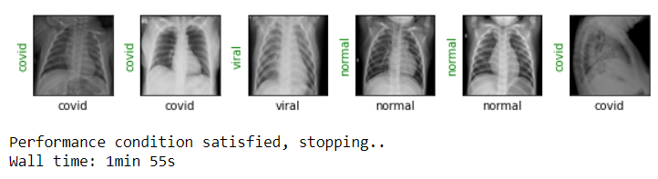
Training Model
The model is trained using the Adam optimizer, CrossEntropy loss function and input and output features.
The input images are put into the model in the form of batches and the model is trained over a definite number of epochs.

Slide 10

Front-End
The front-end is done with HTML 5 and CSS. It is easier to work with Jupyter Notebook when Django is used.
Some Useful links are also added.

Slide 11

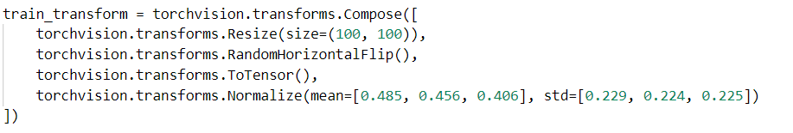
Backend
Pickled file of the deep learning model is loaded in Django using joblib.
Image given by users is fed to the model by applying some transformation.

Slide 12


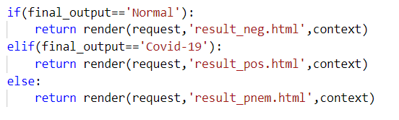

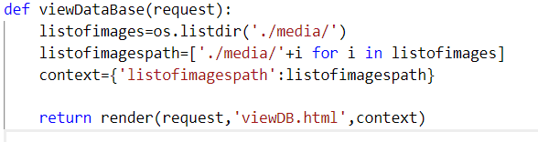
After taking prediction in consideration, redirection from homepage to result page is monitored.
The images that has been given by users has been saved as a database.

Slide 13
Advantages:
Our system gives result faster than the physical test, so the person will get alert earlier and will start taking precaution and hence help preventing the infection further.
If people check first using our resource and then decide to go for physical test if the result is positive, then the load on the test centers will reduce considerably.
This will save money of many unnecessary tests and will help test centers to generate reports faster as load will get reduced.

Slide 14
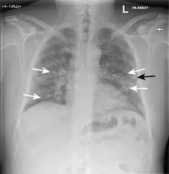
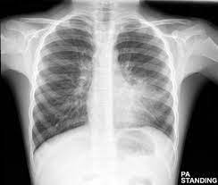
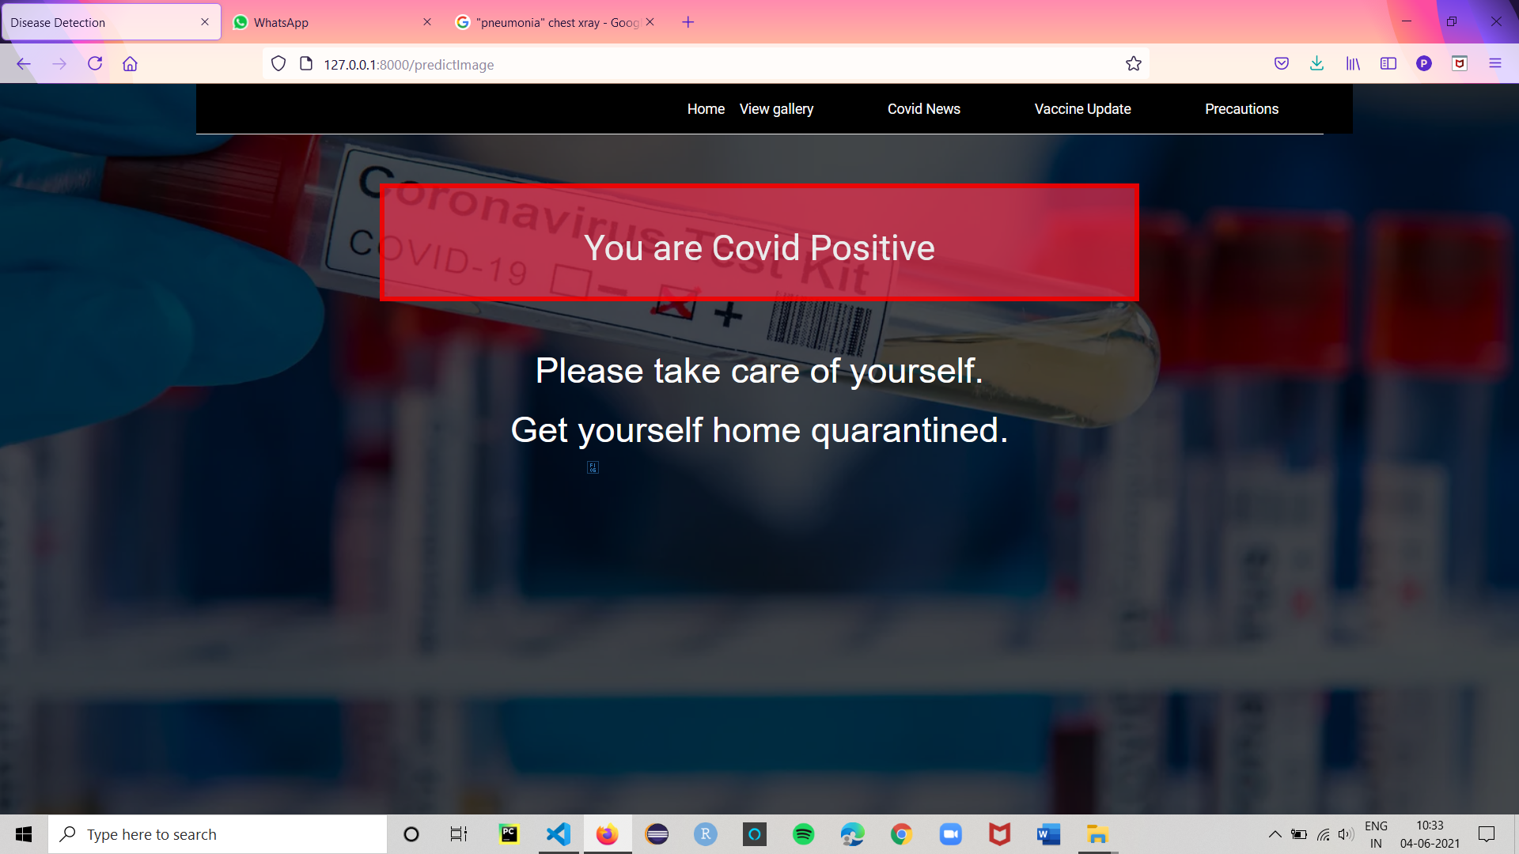
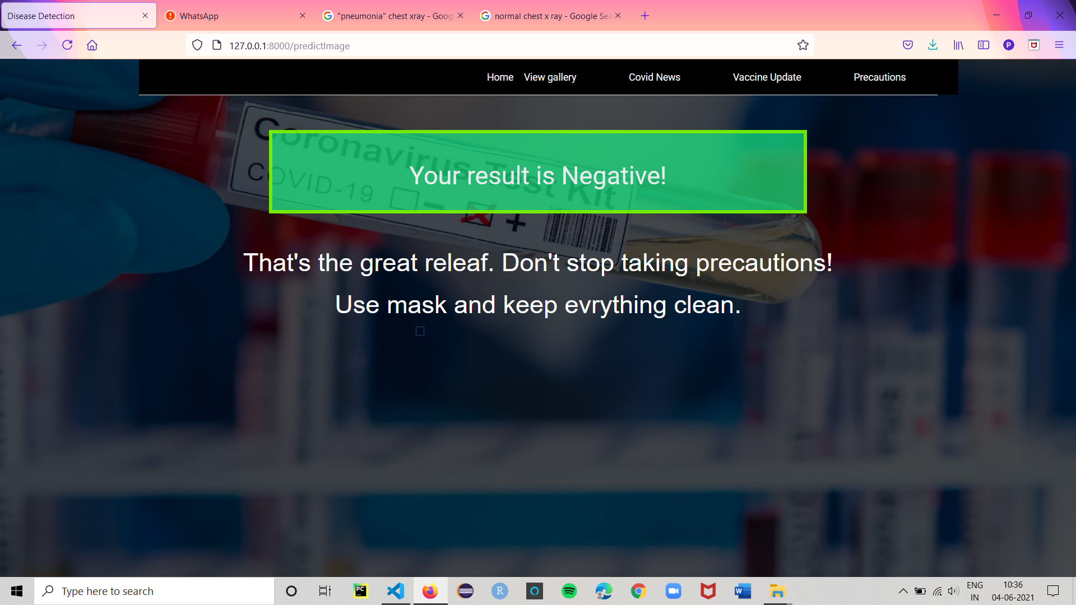
Result
X –Ray of COVID positive patient
X –Ray of COVID negative patient

Slide 15
Conclusion
Our proposed CNN model can detect COVID-19 positive and negative cases effectively and help detect COVID -19 cases early

Slide 16


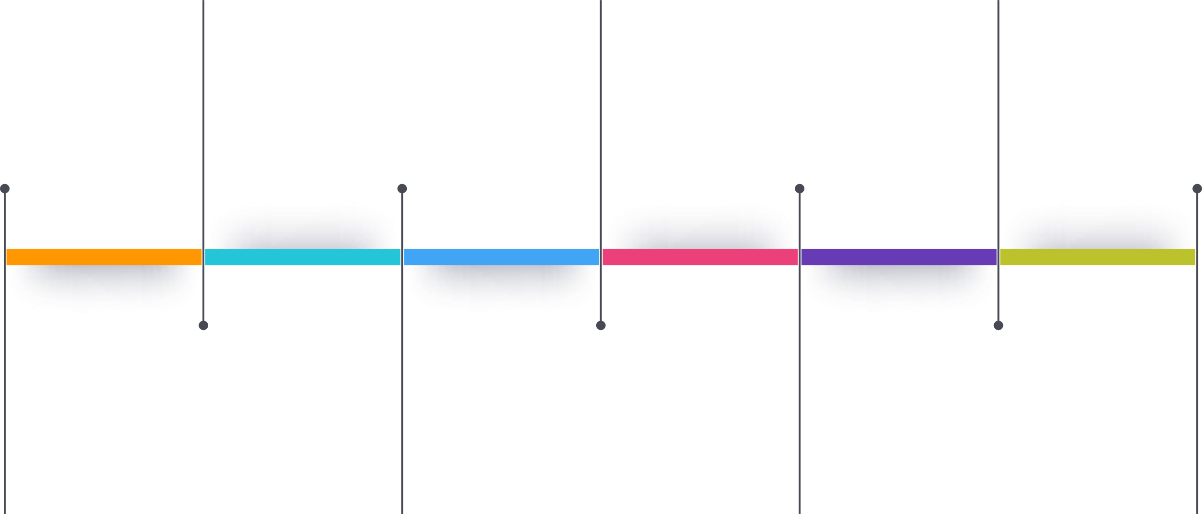
Timeline
Create environment and work on programming.
Complete main programming and get the output.
Connect front-end and backend
Week 1
Week 5
Week 9
Week 3
Week 7
Week 11
Study papers and find resources.
Train dataset.
Work on backend part

Slide 17


References
Asmaa Abbas, Mohammed M Abdelsamea, and Mohamed Medhat Gaber. “Classification of COVID-19 in chest X-ray images using DeTraC deep convolutional neural network”. In: arXiv preprint arXiv:2003.13815 (2020).
Md Zahangir Alom et al. “COVID MTNet: COVID-19 Detection with Multi-Task Deep Learning Approaches”. In: arXiv preprint arXiv:2004.03747 (2020).
Ioannis D Apostolopoulos and Tzani A Mpesiana. “Covid-19: automatic detection from x-ray images utilizing transfer learning with convolutional neural networks”. In: Physical and Engineering Sciences in Medicine (2020).
World Health Organization, "Laboratory testing for coronavirus disease 2019 (COVID-19) in suspected human cases: interim guidance, 2 March 2020," World Health Organization, World Health Organization2020.
S. U. K. Bukhari, S. S. K. Bukhari, A. Syed, and S. S. H. SHAH, "The diagnostic evaluation of Convolutional Neural Network (CNN) for the assessment of chest X-ray of patients infected with COVID-19," medRxiv, 2020.
H. Shi, X. Han, N. Jiang, Y. Cao, O. Alwalid, J. Gu, et al., "Radiological findings from 81 patients with COVID-19 pneumonia in Wuhan, China: a descriptive study," The Lancet Infectious Diseases, 2020.
Linda Wang and Alexander Wong. “COVID-Net: A tailored deep convolutional neural network design for detection of COVID-19 cases from chest radiography images”. In: arXiv (2020), arXiv–2003.

